Slide 1

Quant Week 1
1/25/24
Notes:
Complete

Slide 2

Agenda
Introductions
What is Quant?
Roles in Quant
Semester Overview
Onboarding

Slide 3
Introductions
General Introduction
Name
Year
Major
Where you’re from
Fun Fact

Slide 4


Brain Teaser - Bridge and Torch Problem
Bridge and Torch
4 people need to cross a river.
Only 2 people can cross at a time
Person A takes 10 minutes to cross, person B takes 5, C takes 2 and D takes 1.
It’s dark out so no one can cross without a torch.
Only 1 torch.
What is the fastest way to cross, and how long
would it take?

Slide 5
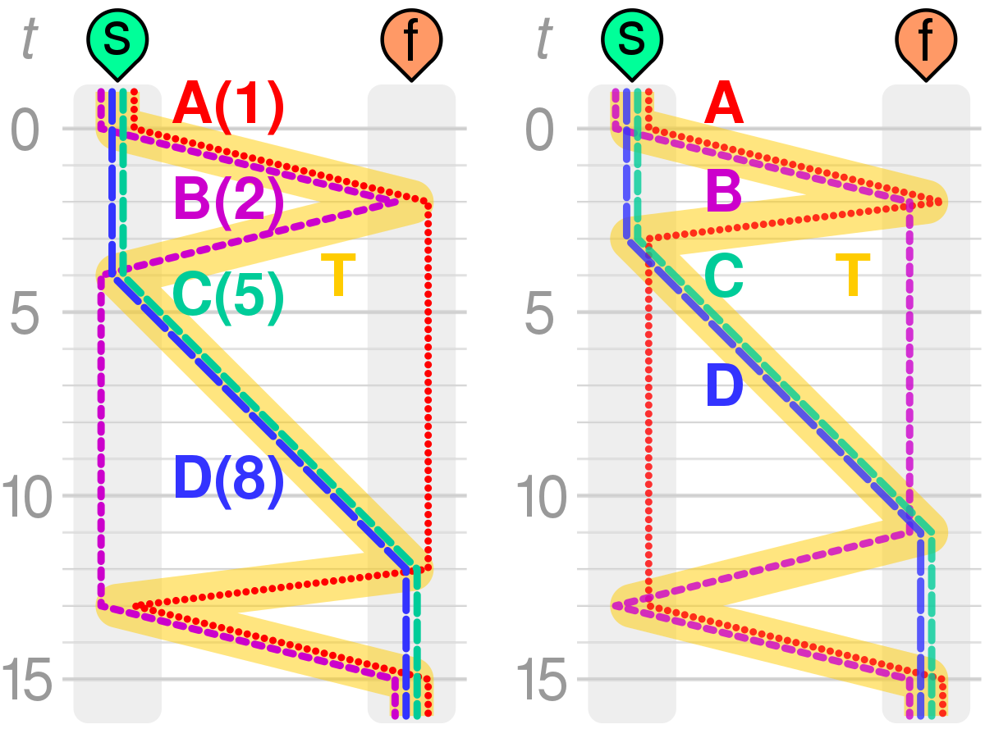
Brain Teaser - Answer
Answer is 17 minutes.
Have the fastest 2 go first
Have either A or B go back
Have C and D cross
Have the other A/B go back to pick up the
last person

Slide 6
What is “Quant”?

Slide 7

Quantitative Finance
Quantitative Finance is essentially just the practice of using programmed models to predict asset prices
The idea is simple to state, but is an incredible complex problem
Within quantitative finance there are a variety of interesting areas and problems to solve
Different asset types
Different roles
Tons of data
Engineering challenges, like trade execution and speed
and massive implications

Slide 8

Asset Classes
Stocks
High volatility stocks like GME, AMC, TSLA
Derivatives/Options
Foreign Exchange (Forex)
Crypto
Sports Betting
Key: high volatility, lots of price movement

Slide 9
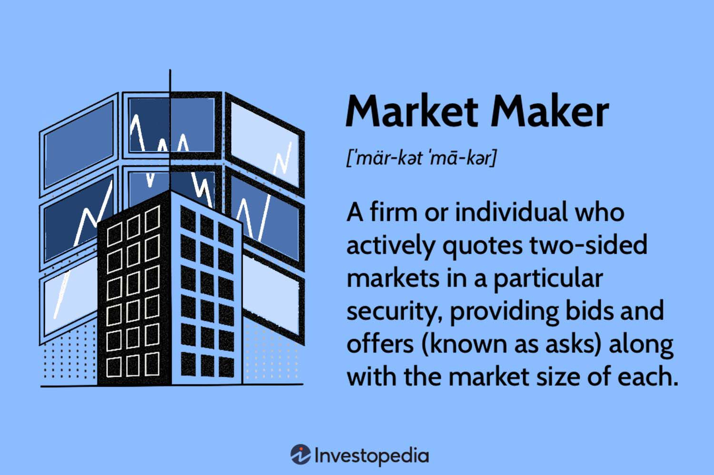
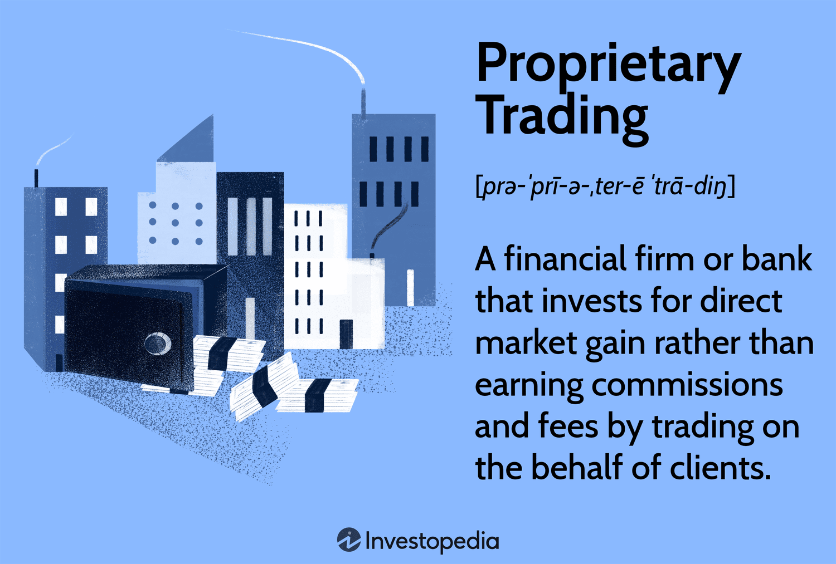
Industry
Market Makers:
Goldman Sachs, Jane Street Capital, SIG
https://www.investopedia.com/terms/m/marketmaker.asp
Prop Trading Firms / HFTs:
Citadel, Optiver, IMC Trading, DRW, Virtu Financial, Chicago Trading Company, Wolverine Trading
https://www.investopedia.com/terms/p/proprietarytrading.asp

Slide 10
Roles in Quant

Slide 11

Roles in Quantitative Finance
Quantitative Traders
Execute trades
Teams divided based on asset class and other factors
Act as a manager to automated trading systems
Change parameters
Respond to the market
Analyze and improve decision making process in post-trade analysis
Involved mathematics background
Much of young traders’ time is spent shadowing other traders and developing what’s referred to as “traders’ intuition”

Slide 12

Roles in Quantitative Finance
Software Engineers
Similar to their big tech counterparts
Manage infrastructure
Deal with scalability
Optimize trading algorithms for speed and efficiency
Low latency programming
FPGAs
Generally working as a SWE in a quant firm is similar to working as a SWE anywhere else, but with higher stakes and an emphasis on efficient system design and speed.

Slide 13
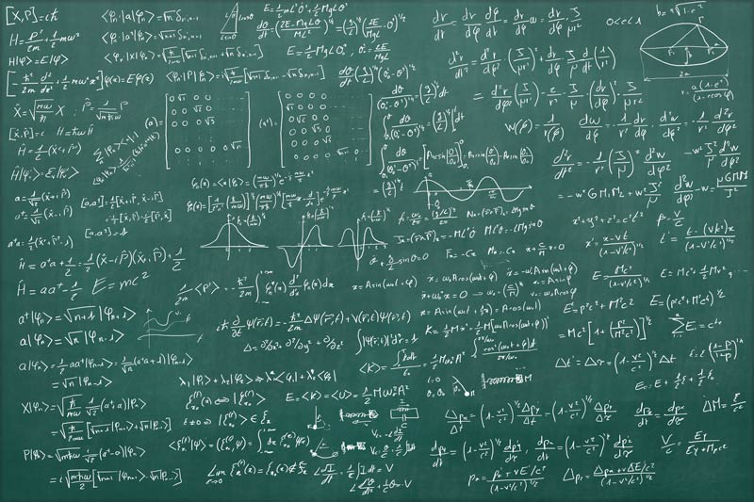
Roles in Quantitative Finance
Quantitative Researchers
Work has aspects of both traders and engineers
Analyze trades
Use statistical inference and data analysis
Develops algorithms at a higher level which will be optimized later
Highly secretive and highly paid
Researchers generally have advanced degrees
(i.e. PhD and less frequently MS)

Slide 14
Semester Overview

Slide 15
Semester Overview
We plan on splitting the meetings into two parts
Education
Trading Strategies
Market Making
High Frequency Trading
Interview Prep
Options Theory
Project Ideas
As a group, build a suite of tools to run, track, and backtest algorithms
Individually, use said trading suite to build, test, and optimize your own models
Would love input from you all on projects you would like to do
Note that this plan is dependent on general experience level and number of returning members.

Slide 16

Onboarding
Link to Onboarding Document, Attendance, Slack and Team Folder

